Slide 1
Walmart Time-Series Sales Forecasting
By Shabrina Ghassani

Slide 2
Background
Walmart is a renowned retail corporation that operates a chain of hypermarkets. Here, Walmart has provided a data combining of 45 stores including store information and monthly sales. The data is provided on weekly basis. Walmart tries to find the impact of holidays on the sales of store. For which it has included four holidays’ weeks into the dataset which are Christmas, Thanksgiving, Super bowl, Labor Day.
The total datasets have 421,570 rows (after cleaning).
Our goal is to predict the Weekly Sales for from Walmart Store Sales database.

Slide 3
Data Understanding

Slide 4
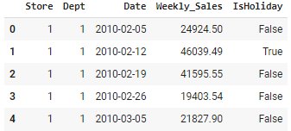
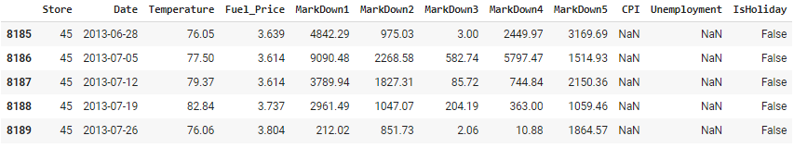
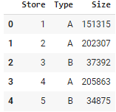
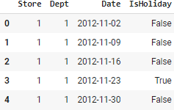
The Datasets
Train
Features
Stores
Test
Store - the store number
Dept - the department number
Date - the week
Weekly_Sales - sales for the given department in the given store
IsHoliday - whether the week is a special holiday week
Temperature - average temperature in the region
Fuel_Price - cost of fuel in the region
MarkDown1-5 - anonymized data related to promotional markdowns that Walmart is running. MarkDown data is only available after Nov 2011, and is not available for all stores all the time. Any missing value is marked with an NA.
CPI - the consumer price index
Unemployment - the unemployment rate

Slide 5




Data Cleaning
Missing Values
Handling
Merging the Datasets
Splitting Date Column
Data Duplicate
>50% in MarkDowns: Fill the NA values with 0.
~7% in CPI and Unemployment: Fill with median.
Merge train, stores, and features datasets by Store and Date features.
Zero duplicated data.
Split date column to Day, Week, Month, Year, for analysis.

Slide 6
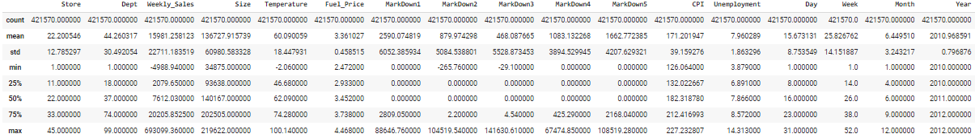
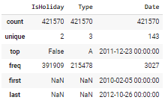
EDA
Observation of numerical features:
The min.Weekly_Sales is negative. Possibly because there is a return but there is no sale/sales value is smaller than the value of the item being returned.
There are also negative MarkDowns.
Store, Dept, and Size are discrete values. No need to infer the symmetry.
Weekly_Sales, MarkDowns, CPI columns have skewed distribution because there is quiet a difference between the mean and the median
Observation of categorical features:
IsHoliday only has 2 values, "True" or "False".
Most Walmart stores are Type A.
The dataset is historical data for 2 years and 9 months.
Since the only unique day is Friday, it shows that this data reflects weekly transactions. Therefore, we can't perform the daily analysis.

Slide 7
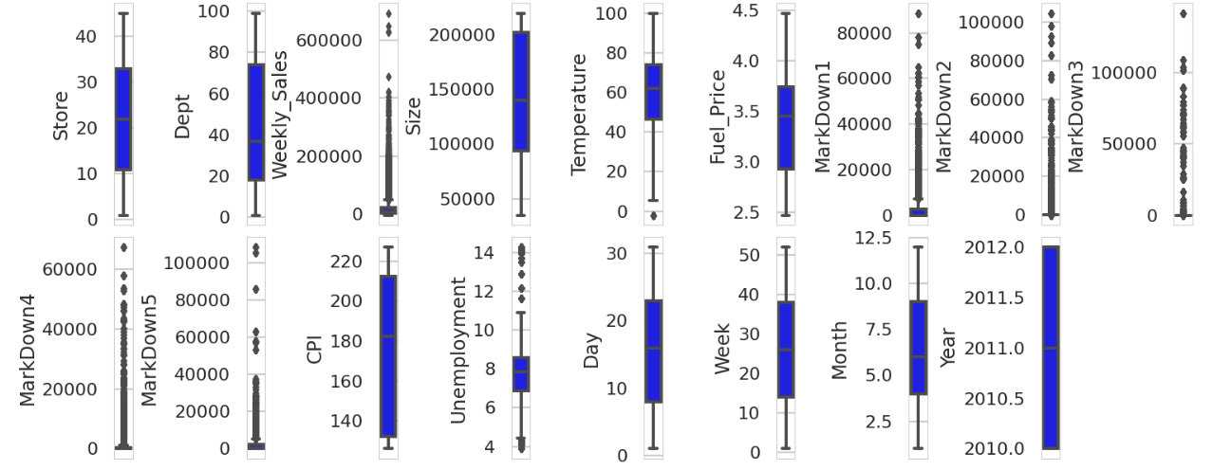
EDA: Univariate Analysis
Observation:
`MarkDowns` have so many outliers. Will determine later if it will be used for modelling.
`Weekly_Sales` and `Unemployment` also have many outliers, but not as much as `MarkDowns`.

Slide 8
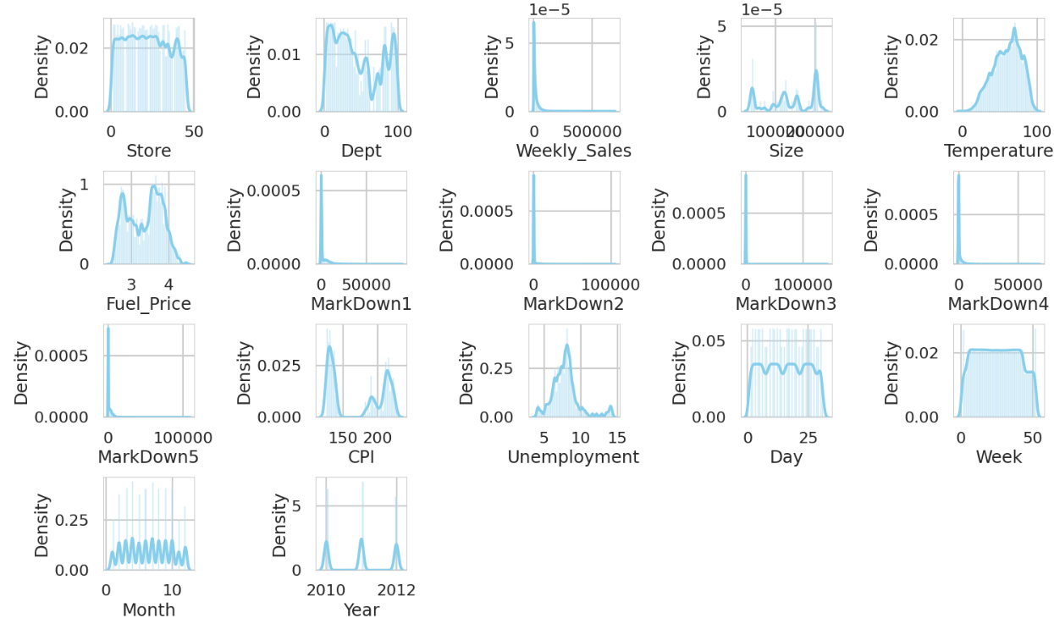
EDA: KDE Plot for Knowing the Distribution Form
Observation:
We can ignore interpreting feature columns with limited discrete values such as `Day`, `Week`, `Month`, `Year`, `Store`, `Dept`, `Size`
The true continuous numeric features: `Temperature`, `Fuel_Price`, and `Unemployment` are somewhat symmetric, which is good (no need to transform them to approximate normal distribution). However, for `CPI`, it seems like it's bimodal distribution.
`MarkDowns` are positively skewed.
In terms of the target variable, `Weekly_Sales` is positively skewed.

Slide 9
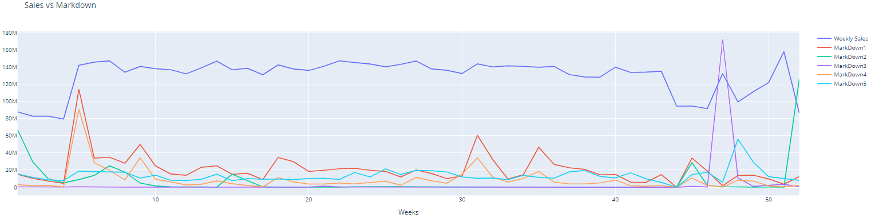
EDA
There are lots of discounts in week 5-8, 46-48, dan 51-52. There’s Super Bowl in week 5-8, Thanksgiving and Black Friday in week 46-48, and Christmas in week 51-52.
Sales increases as the discounts (markdowns) increases.

Slide 10
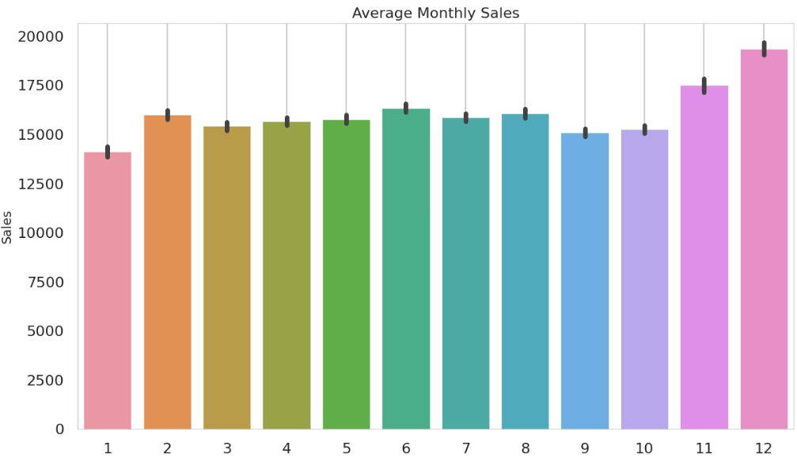
EDA
Align with the high discount in the previous slide, sales increases in the same months as the discount increases.

Slide 11
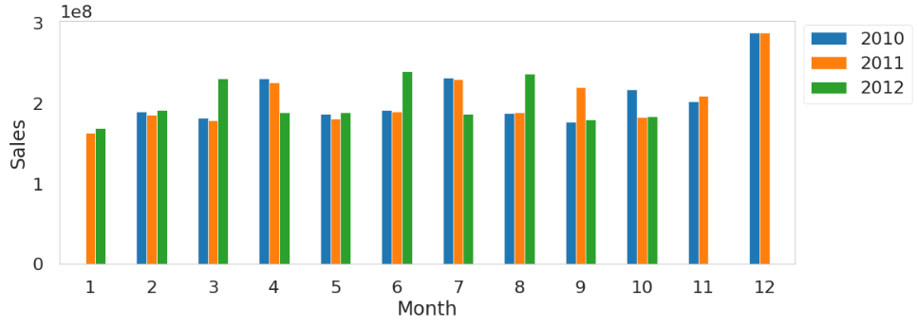
EDA
Monthly Sales for Each Year
Observation:
Sales trends in February, November and December each year are not much different. This is because Super Bowl in February, Black Friday and Thanksgiving in November, Christmas in December.
Sales trend in May is also not much different each year.

Slide 12
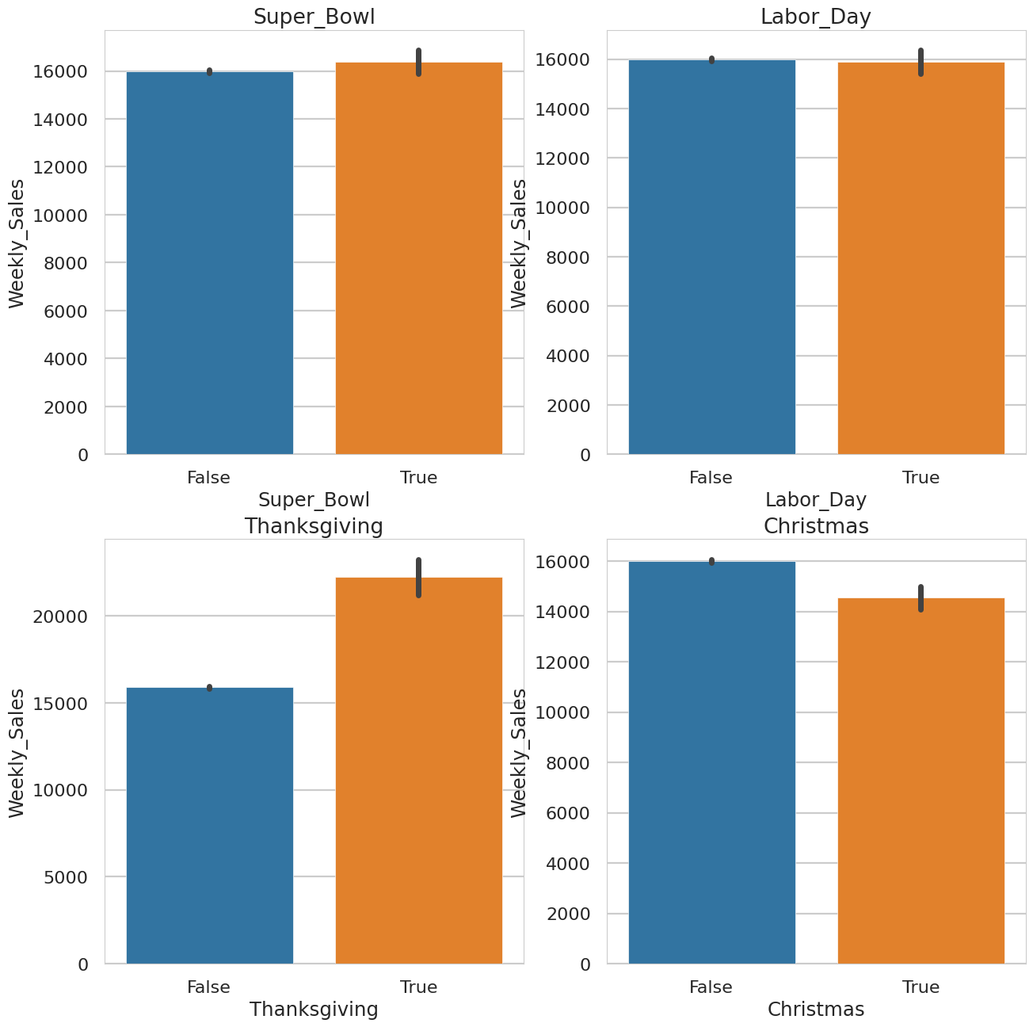
EDA
Holiday vs Not-Holiday
I create new columns for 4 types of holidays and fill them with boolean values. If date belongs to this type of holiday, it is True, if not then it’s False.
There is a significantly positive effect on sales in Thanksgiving. I think, people generally prefer to buy Christmas gifts 1-2 weeks before Christmas, so it does not change sales in the Christmas week. And, there is Black Friday sales in the Thanksgiving week.

Slide 13
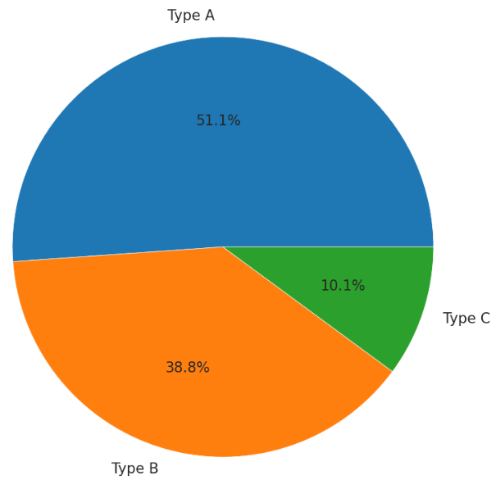
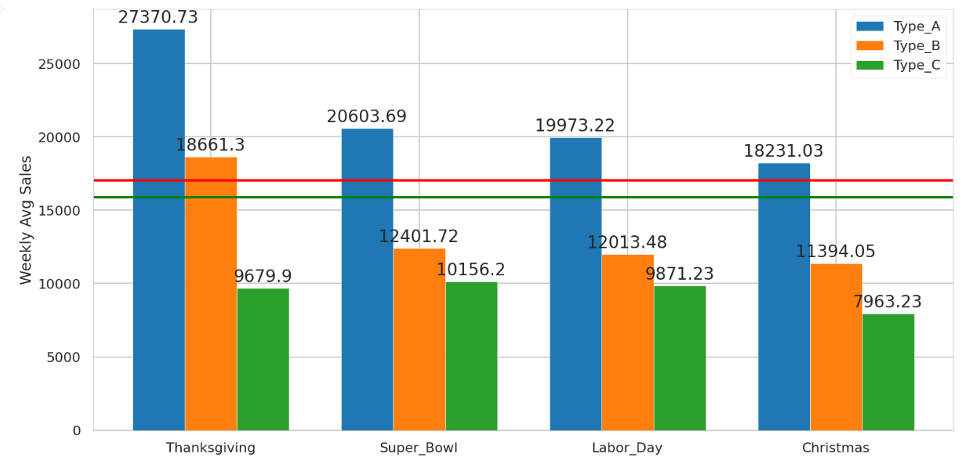
EDA
Percentages of Store Types
Store Type Effect on Holidays
Weekly Sales Holiday Avg
Weekly Sales Not-Holiday Avg
It’s seen from the graph that, highest sale average is in the Thanksgiving week between holidays. And, for all holidays Type A stores has highest sales.

Slide 14
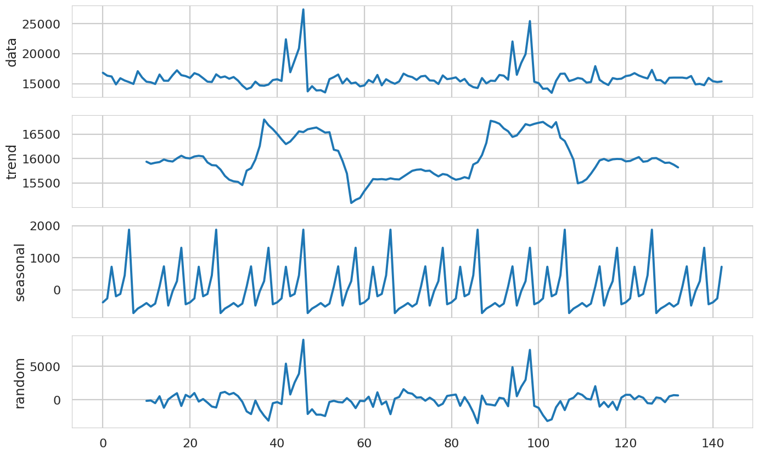
EDA: Time Series Decomposition
Time series decomposition helps to deconstruct the time series into several component like trend and seasonality for better visualization of its characteristics. Using time-series decomposition makes it easier to quickly identify a changing mean or variation in the data.
From the graphs above, every 20 step seasonality converges to beginning point. There's a strong seasonal behavior.

Slide 15
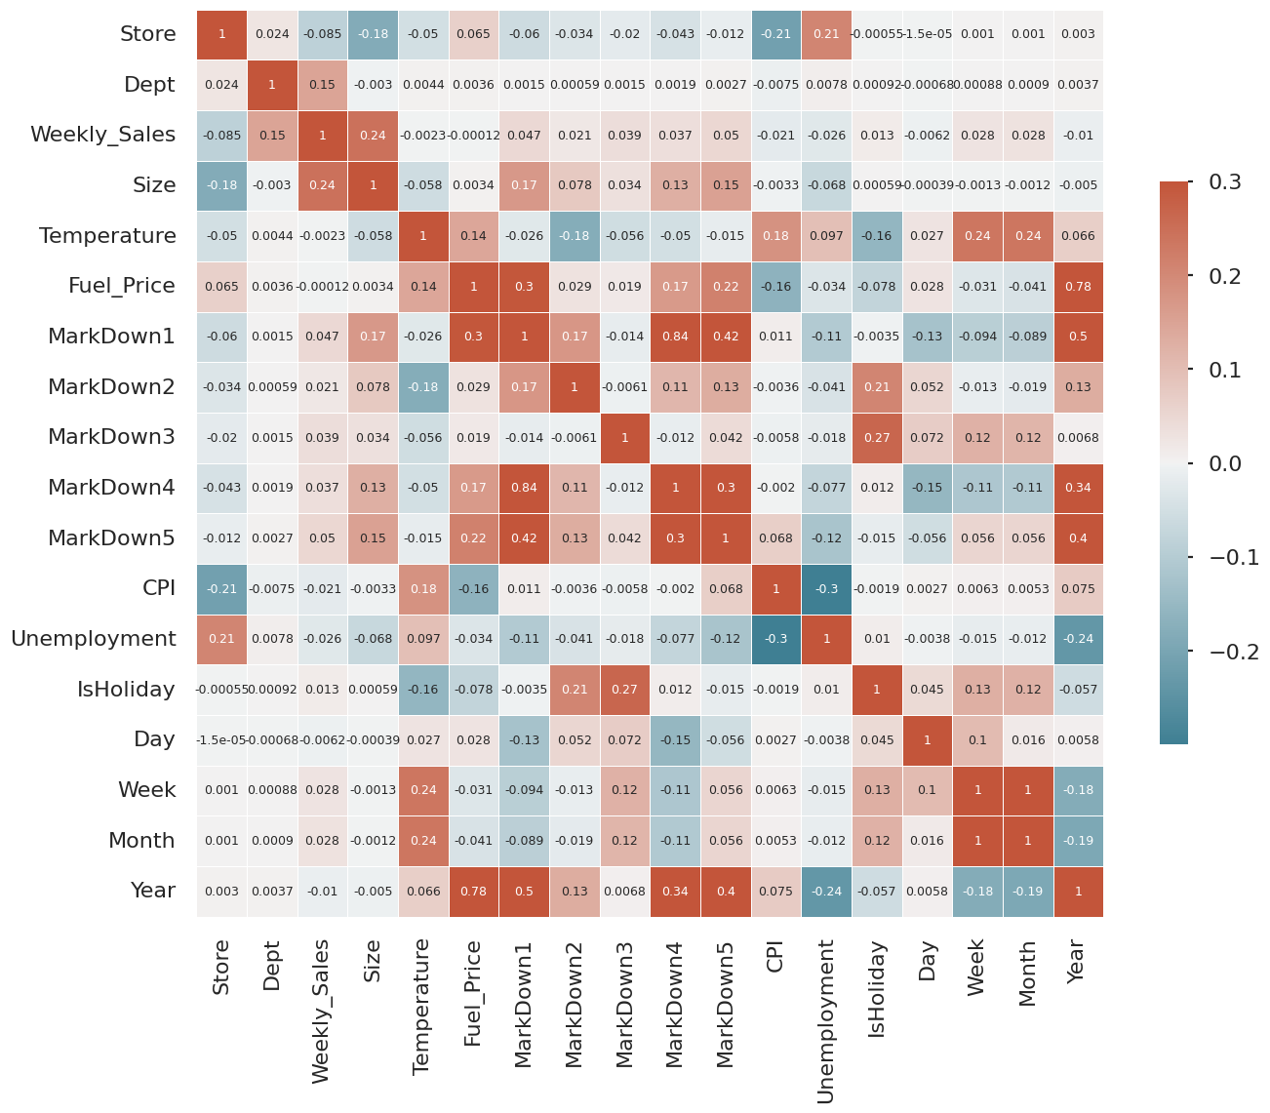
EDA: Correlation Matrix
When we look at the correlation matrix, we can see that `Weekly_Sales` have a higher correlation ( abs(corr)>0.05) with:
`Store`
`Dept`
`Size`
This is a really important insight because, as we know, being able to correctly predict weekly sales on Holidays is extremely important. However, the correlation between `IsHoliday` and `Weekly_Sales` has a lower value (0.013).
Despite having a low correlation, we need to remember that this feature only happens 4 times a year besides being a really important one considering our problem.
Additional info: We can drop some features here since most of the MarkDown columns are not available and in this case, Walmart specified that those values are not consistent since we don't have them for every store all the time. MarkDown1-5 - anonymized data related to promotional markdowns that Walmart is running. MarkDown data is only available after Nov 2011, and is not available for all stores all the time. Any missing value is marked with an NA.

Slide 16
Feature Engineering & Preprocessing

Slide 17
Feature Engineering
Preprocessing
Add HolidayType column: [-1 = No Holiday, 0 = Super Bowl, 1 = Labor Day, 2 = Thanksgiving, 3 = Christmas]
Transform all categorical features into ordinal categories using OrdinalEncoder. Here, we use this transformation for the column Type.
Standardize numerical features by removing the mean and scaling to unit variance using StandardScaler.

Slide 18
Training

Slide 19
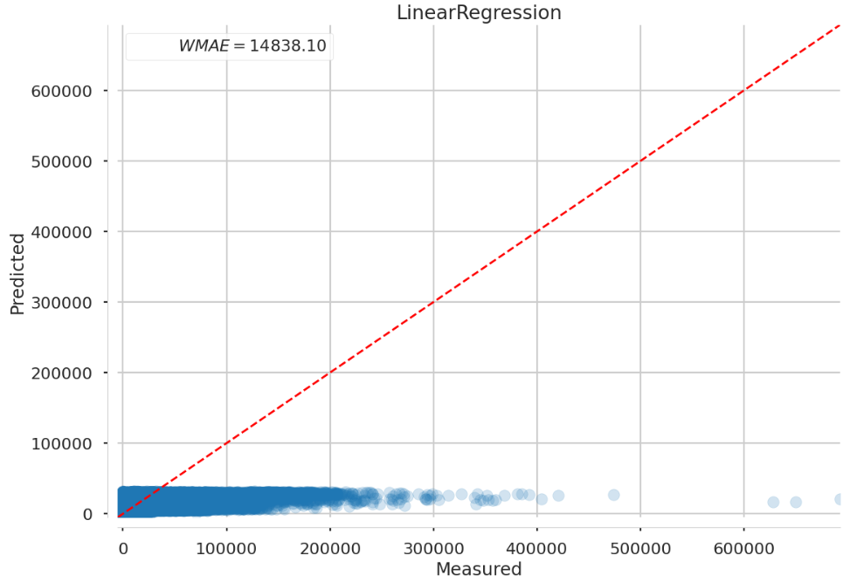
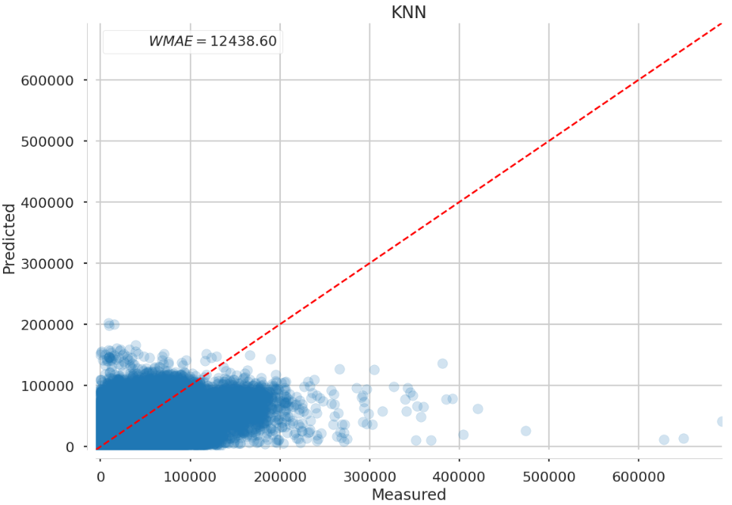
Step 1: Find the Best ML Model Type
In this section, I used some regression models to find the better one considering WMAE evaluation on hyperparameter combination.
The following regression models were tested: Linear Regression, KNN, Ridge, Lasso, XGBRegressor, RandomForestRegressor, and ExtraTreesRegressor.
The better model will be the one with the lowest WMA.

Slide 20
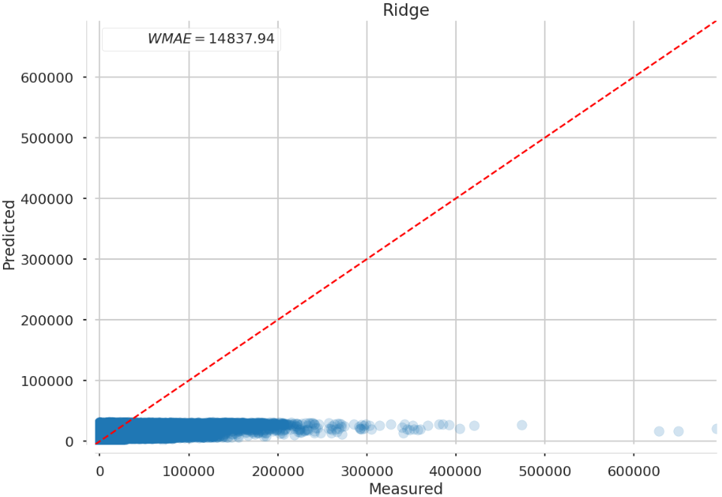

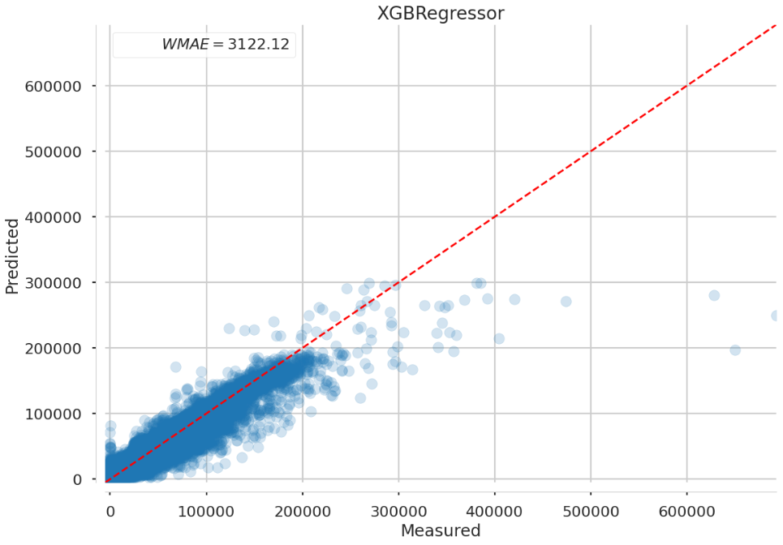
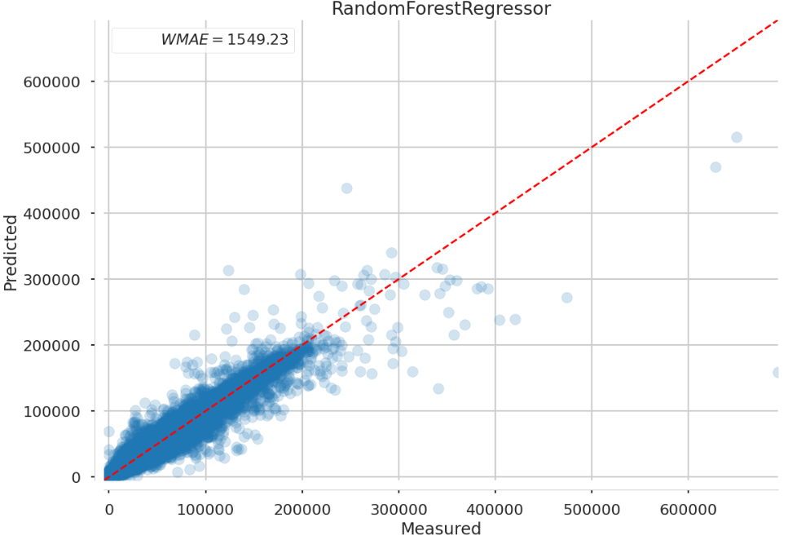
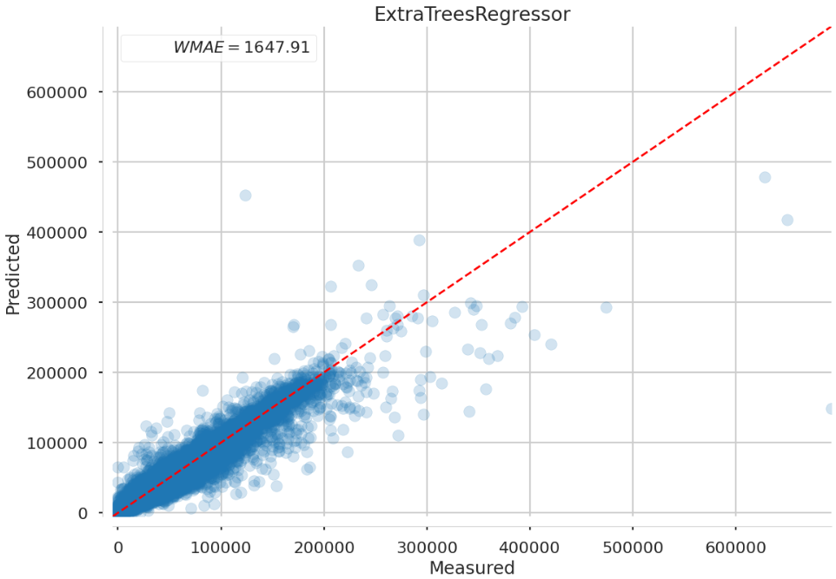

Step 1: Find the Best ML Model Type

Slide 21
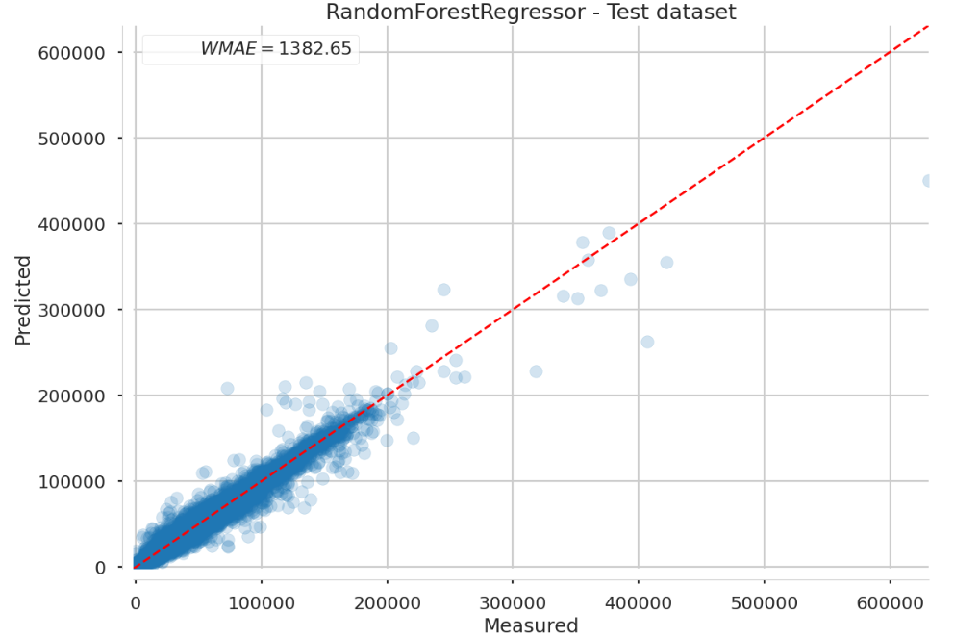
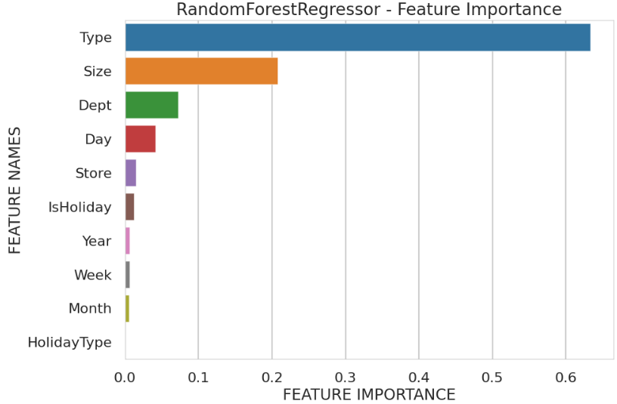
Step 2: Find the Best Hyperparameter Combination
After finding the best model, we need to find the best combination of hyperparameters. For simplicity's sake, this step was only implemented for the two models with the lowest on Step 1: ExtraTreesRegressor and 2. RandomForestRegressor.
The strategy used here is finding the best hyperparameter combination using GridSearchCV approach.
Step 3: Training the Full Dataset

Slide 22
Testing the Model

Slide 23
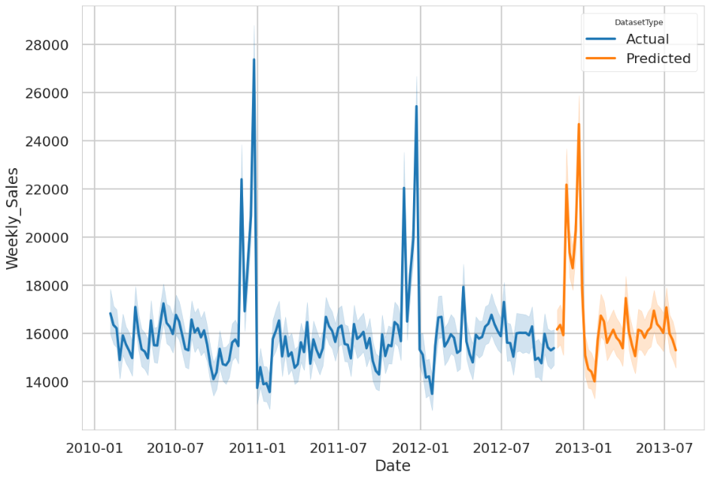
Testing Our Model
After model training, we can apply the resulting model to the test dataset provided by Walmart.
On this set, we apply our whole model pipeline on this data (Preprocessing + Model) using best_model_pipeline and plot a graph to see our estimation on the test dataset.

Slide 24
Conclusion
&
Recommendation

Slide 25
Conclusion
Recommendation
From the models that we have tested, the best model to use is RandomForestRegressor.
Our model can capture the seasonality of Walmart Time-Series Sale.
Continue to provide lots of discounts during and a week before holidays, especially Thanksgiving and Christmas because it significantly increases the sales.
Provide the most holiday discounts at Type A and B stores (especially during Thanksgiving), as these two stores can exceed their average weekly sales.
Continue record the Markdowns details since it’s very useful for analysis, as there are still lots of missing values now.
Would be better if transaction details be entered into the system per day, not just on Friday so that analysis can be carried out in more depth by analyzing daily transactions if necessary.

